Slide 1
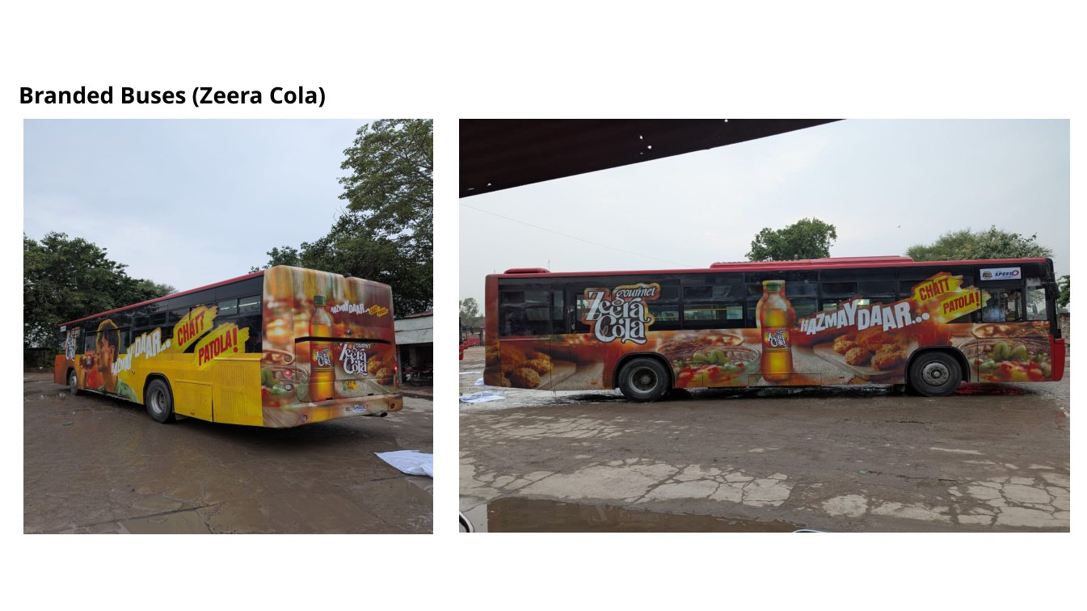
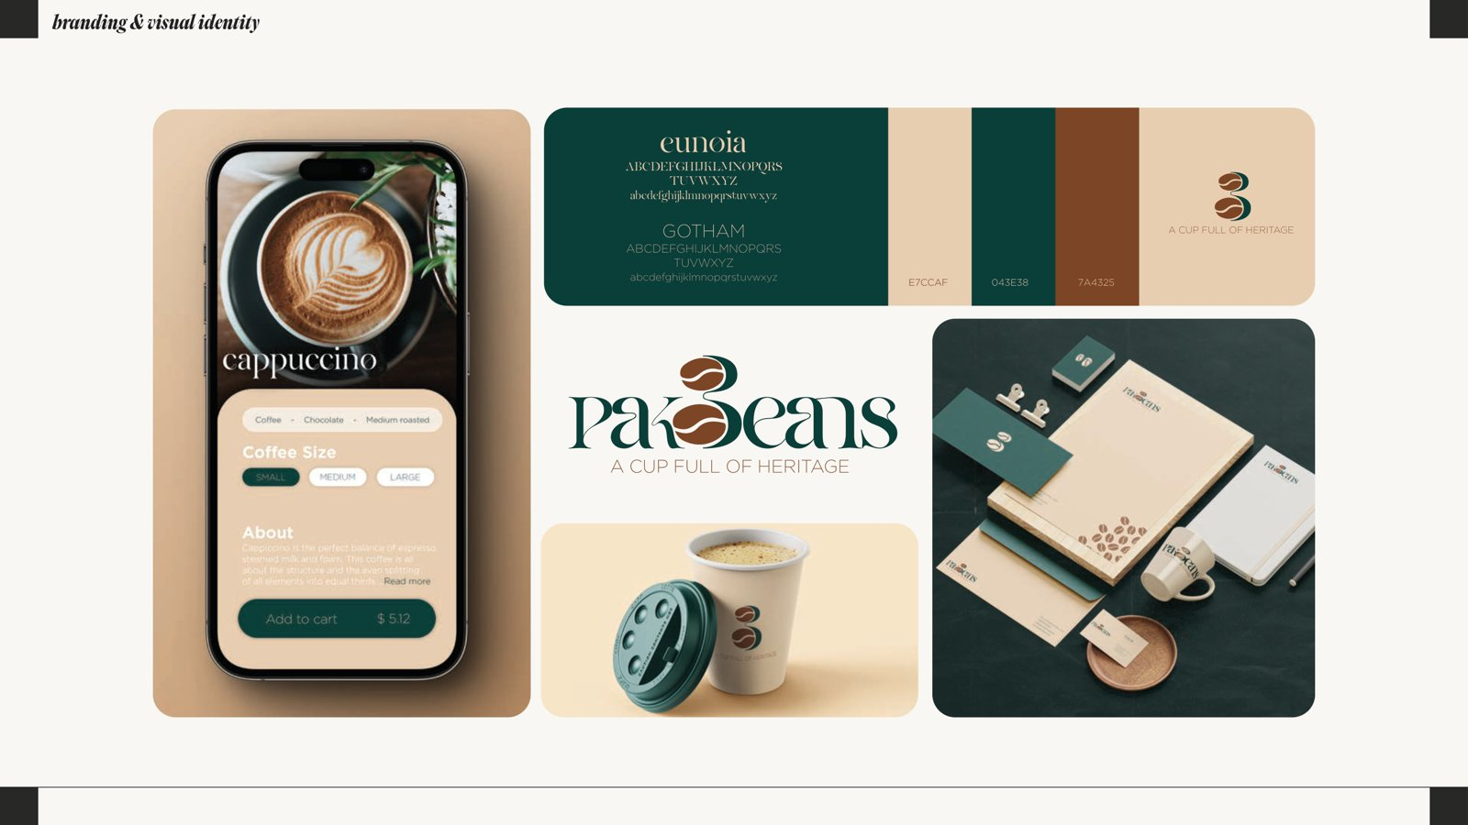
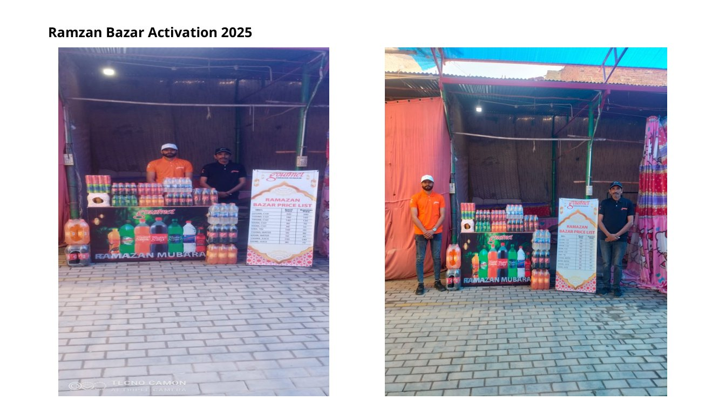
CREATIVE LINKAGE
Building the brands together
Professional Portfolio
Presentation
Activation / OOH proof
360° brand activation, retail visibility, POSM, creative design, writing, research support and technical documentation — presented with proof discipline.
Brand identity proof
Seasonal activation proof
Prepared from uploaded source batches only. No unsupported achievement has been converted into a confirmed claim.
Creative Linkage | Professional Portfolio
01

Slide 2
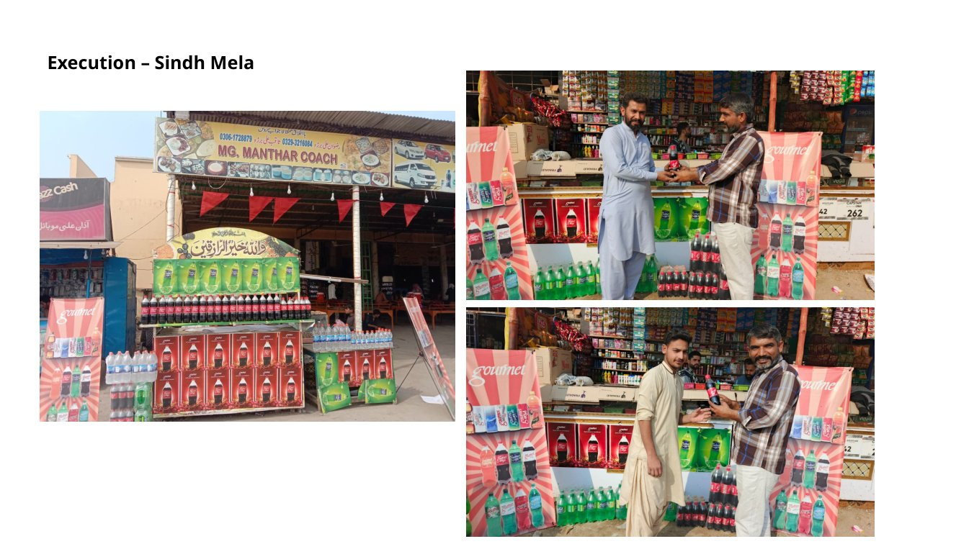
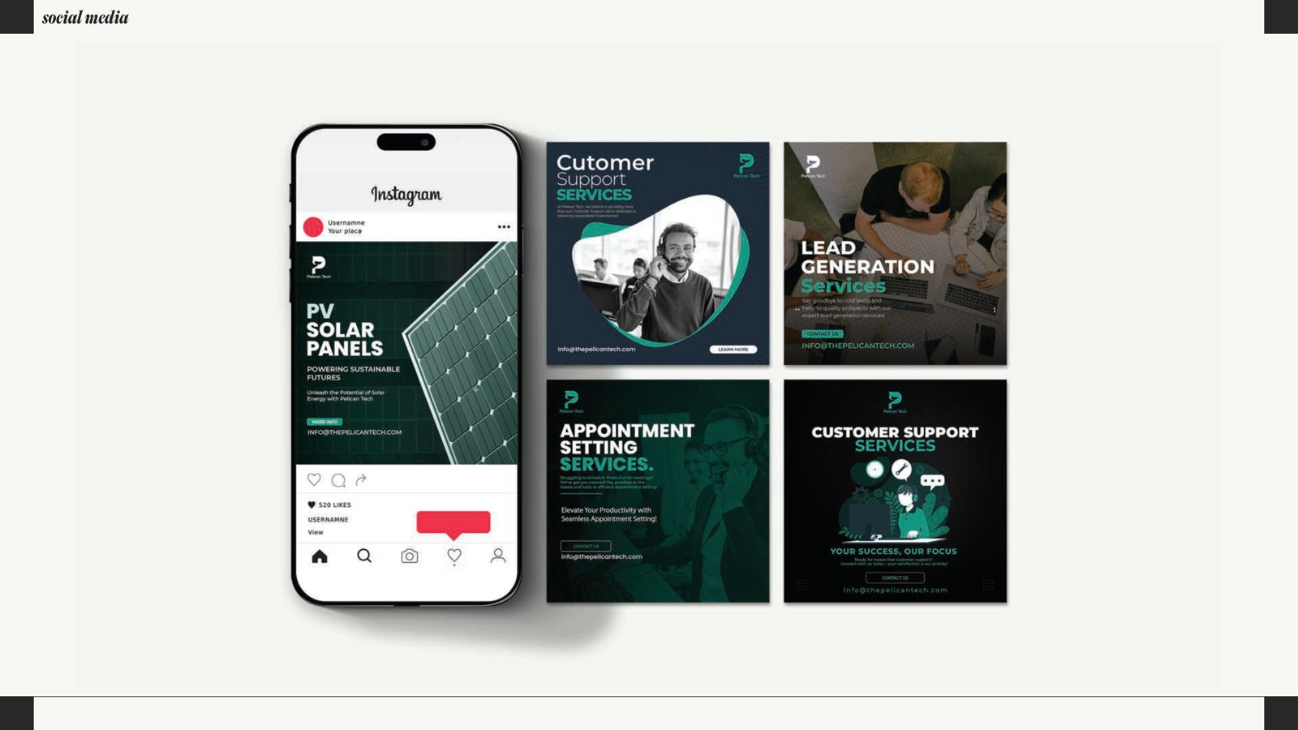
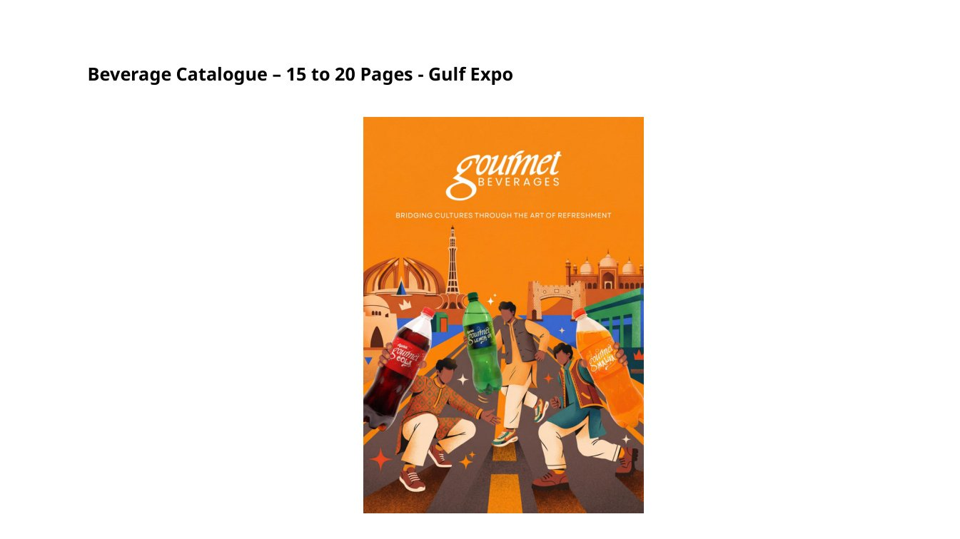
EXECUTIVE PORTFOLIO SUMMARY
A 360° execution partner for brands that need visibility, structure and market action.
Creative Linkage is positioned as an integrated brand activation and marketing company. The strongest public-facing proof is visual and execution-heavy: activations, sponsorships, retail branding, POSM, packaging/label process work, social media assets, design systems, and professionally structured writing support.
360°
9
44
Strict
On-ground execution evidence
activation + marketing capability
service portfolios mapped
visual proof assets in master file
proof standard used
Digital design
Expo collateral
Creative Linkage | Professional Portfolio
02

Slide 3
PORTFOLIO INTEGRITY
Professional portfolios win trust by showing evidence without exaggeration.
Only uploaded material used
The deck is built from the master evidence file and extracted visuals.
Claims separated from proof
Unsupported claims remain source statements, not verified achievements.
Sensitive material protected
Academic, personal and internal documents require anonymization before public use.
Brands handled carefully
Academic case subjects are not presented as endorsements unless direct engagement proof exists.
Damaged archive noted
One Coca-Cola ZIP was structurally damaged; usable Word/PPT files were recovered where possible.
Recommended public position: move brands from visibility to market action through activation, retail branding, POSM, packaging support, digital content and execution systems.
Creative Linkage | Professional Portfolio
03

Slide 4
SOURCE MATERIAL INVENTORY
Every portfolio claim is anchored to a reviewed source batch.
Source file | Type | Major content detected | Status
Portfolio Headers & Content.docx | DOCX | Profile, services, mission, vision, positioning, counters | Parsed
Task Feb to Apr-26.zip | PPTX in ZIP | 280-slide activation, sponsorship, POSM, retail, label/process proof | Parsed / selected slides rendered
WhatsApp Image ZIP | 14 JPEGs | Visual proof images from uploaded batch | Extracted
Abdullah Design Portfolio.pdf | PDF | 18-page graphic design portfolio by Umair Mughal (2023–24) | Parsed / selected pages rendered
loreal.zip | 42 files | L’Oréal, Nestlé, P&G, PepsiCo, Unilever writing packages | Inventoried
australia work.zip | 128 files | Academic writing, BRM, Foodpanda data, SPSS/SmartPLS | Inventoried
cloud management assignment.zip | 84 files | Cloud, cyber, leadership, finance, strategy/sustainability | Inventoried
coca cola.zip | Corrupt / partial ZIP | Recovered Coca-Cola DOCX and PPTX; one DOCX could not be opened | Partially recovered
old.zip | 7,638 files | Legacy archive: CVs, digital marketing, cloud, health care, packet tracer, lab reports, Python | Inventory-level review
final evidence batch | 390 files | Research, data science artefacts, SPSS/SPV, SmartPLS, dissertation materials | Inventory-level review
Creative Linkage | Professional Portfolio
04

Slide 5
UNIVERSAL SERVICE PORTFOLIO
One portfolio, nine service lines.
Designed for brand teams, startups, SMEs, retail operators, academic researchers and technical teams.
Brand activations
Events & exhibitions
Retail branding & POSM
Packaging & label support
Branding & graphic design
Social media & digital design
Copywriting & business writing
Thesis / research support
Technical report writing
Creative Linkage | Professional Portfolio
05

Slide 6
WHAT CREATIVE LINKAGE CAN OFFER
The offer is broad, but each service has proof-backed examples.
Service portfolio | What can be offered | Proof-backed examples
Brand activations | Float activations, roadshows, sampling/free trials, rural outreach, category consultant and merchandiser programs. | Zeera Cola bakery activation, Ramzan Bazar 2025, Sindh Mela, Pakistan Navy and Sunwai sponsorships.
Events & exhibitions | Planning, space branding, sponsorship materials, booth collateral, product presence and field execution. | Pakistan Navy Hockey Tournament, Gulf Expo collateral, BNU Nothing Fest, Sindh Mela.
Retail branding & POSM | Shop visibility, gondolas, BIB machines/boxes, signage, stickers, catalogues, coasters, bags, key chains. | BIB machine/box branding, Gourmet glasses, Gulf Expo key chains, beverage catalogue, POSM banners.
Creative packaging & label support | Label workings, comparative label reviews, barcode/GS1 evidence, PSQCA/PFA placement/process support. | GS1 Pakistan barcodes, label revisions, ingredients/facts verification, product/bottle updates.
Branding & graphic design | Logo systems, palettes, typography, mockups, identity boards, campaign posters. | Pakeans, Khooji, Koyal, Wrappies, WWF-style, Alkhidmat, UCAD posters.
Social media & digital design | Static post design, campaign creatives, lead generation content, support service visuals, food promos. | Pelican Tech social media, Spice of Life restaurant creatives.
Creative Linkage | Professional Portfolio
06

Slide 7
WRITING, RESEARCH AND TECHNICAL CAPABILITY
A supporting service layer for documents, analysis and technical reporting.
Service portfolio | What can be offered | Proof-backed examples
Copywriting & business writing | Company profiles, service copy, business case reports, operations, global strategy, ethics, finance and leadership assignments. | Creative Linkage website copy; L’Oréal, Nestlé, P&G, PepsiCo, Unilever, Coca-Cola business writing packages.
Thesis / research support | Questionnaire design, SPSS/SmartPLS files, coded sheets, dissertation/research documents and analysis support. | Foodpanda BRM research, questionnaire/consent templates, SPSS/SPV/SmartPLS evidence.
Technical report writing | Cybersecurity, cloud management, finance, data artefacts, packet tracer, lab reports and technical summaries. | Cloud management, cybersecurity compliance, Bitcoin anomaly detection, phishing email artefact, lab reports.
Web / automation / project documentation | Project documentation, technical summaries, code artefact guides, system notes and documentation packs. | CIS017-3 artefact user guide, technical summary, Python/IPYNB/code outputs, legacy Python archive.
Presentation rule: raw academic, personal and technical files should be summarized, anonymized and sanitized before external sharing.
Creative Linkage | Professional Portfolio
07

Slide 8
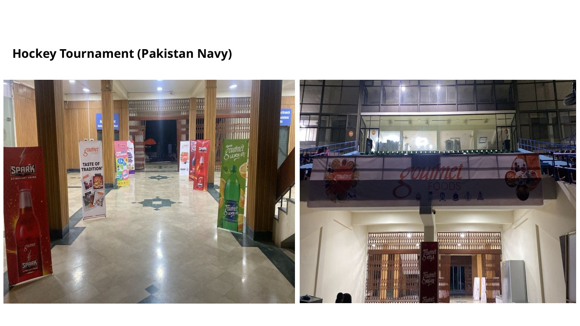
FLAGSHIP ACTIVATION PROOF
Visibility that reaches the street, the store and the event floor.
Zeera Cola branded buses
Ramzan Bazar Activation 2025
Sindh Mela execution
Pakistan Navy sponsorship
Use these as the visual backbone of the marketing agency portfolio, subject to brand permission.
Creative Linkage | Professional Portfolio
08

Slide 9
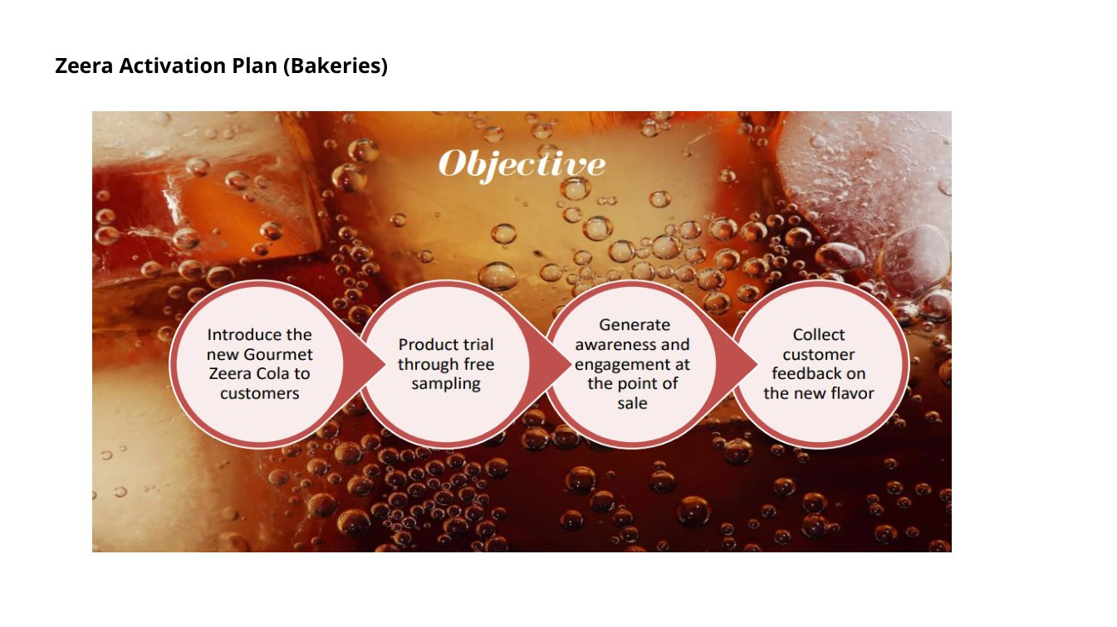
CASE STUDY: ZEERA COLA / GOURMET ACTIVATION & VISIBILITY
A flagship example of brand activation, OOH and retail execution.
Bakery activation plan
Branded buses
Seasonal booth execution
Field | Details
Service category | Brand activation, OOH, retail execution
Work completed | Branded buses, bakery activation planning, Ramzan Bazar setup, shirts/caps and POSM material.
Proof available | Multiple visual proofs in the Task Feb to Apr-26 deck.
Portfolio positioning | Position as a flagship activation and retail visibility case.
Creative Linkage | Professional Portfolio
09

Slide 10
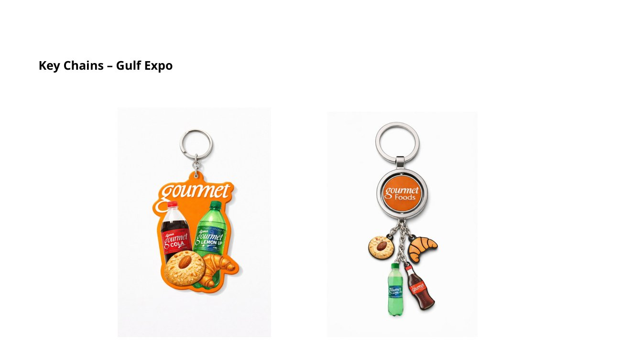
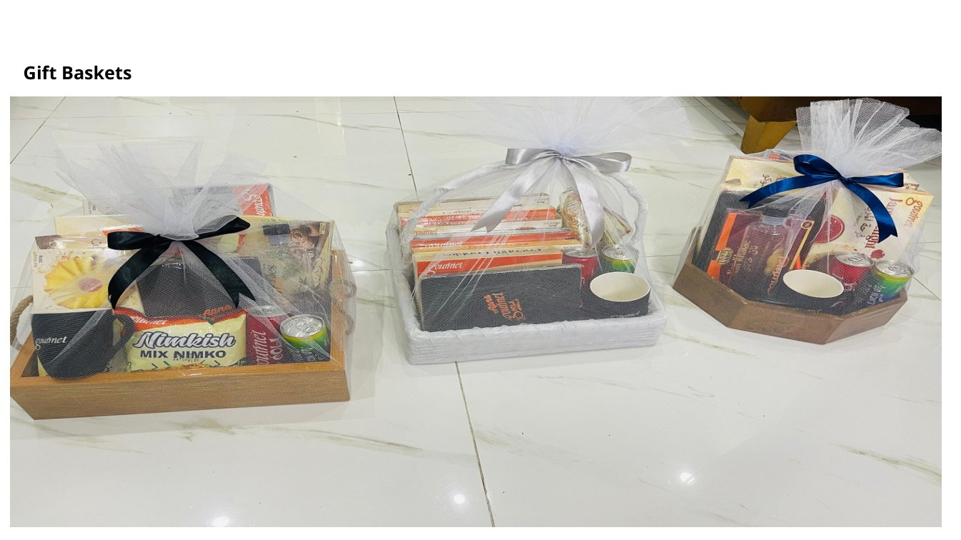
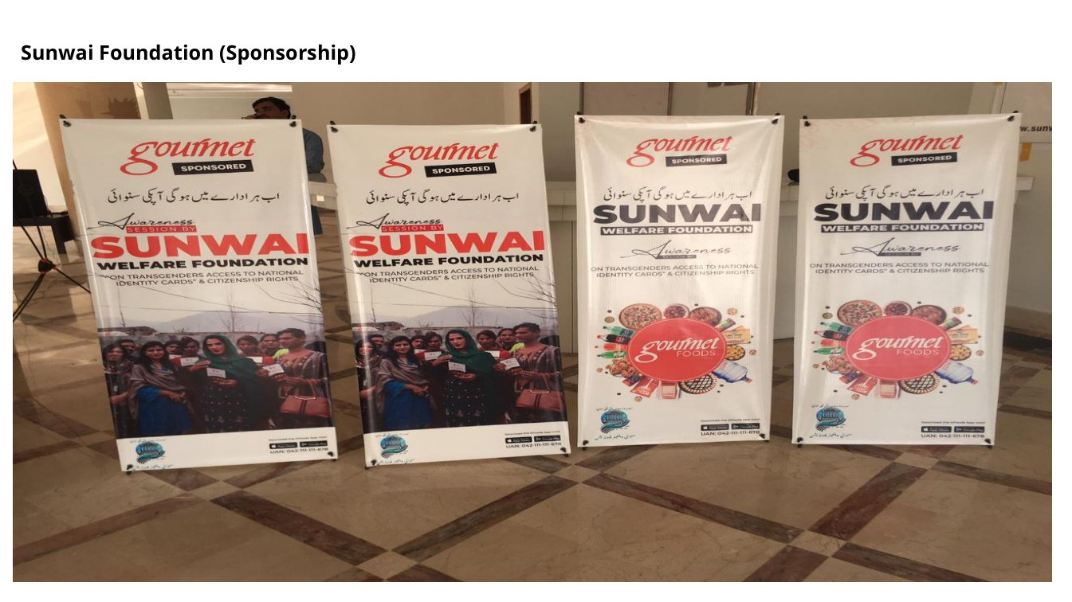
CASE STUDY: GULF EXPO COLLATERAL SUITE
A polished example of event collateral, POSM and merchandise execution.
Key chains
Beverage catalogue
Gift baskets
Sponsorship boards
Field | Details
Service category | Expo collateral and POSM
Work completed | Key chains, playing cards, table coasters, tote/catalogue bag and beverage catalogue.
Proof available | Proof slides for collateral designs and execution.
Portfolio positioning | Strong for event and exhibition pitches.
Creative Linkage | Professional Portfolio
10

Slide 11
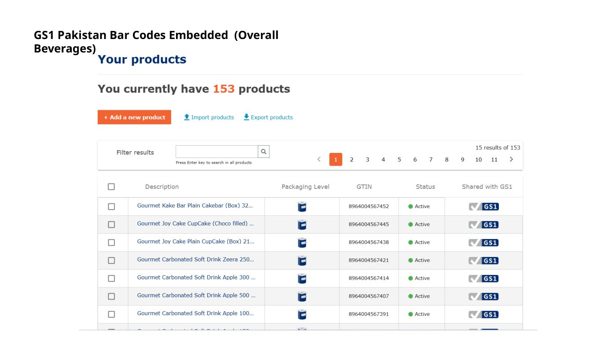
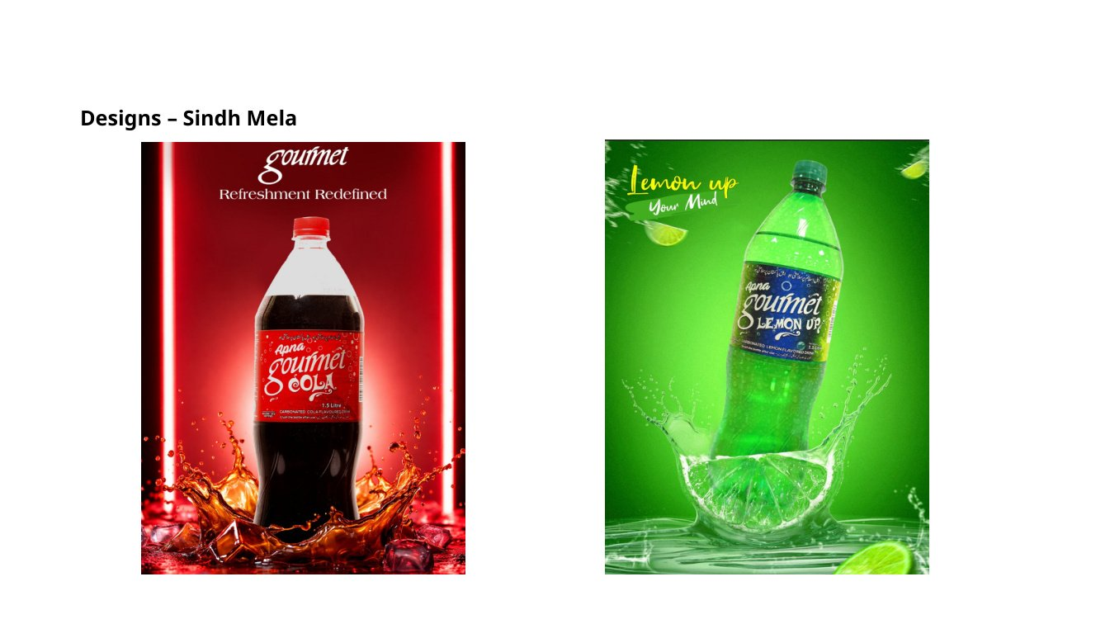
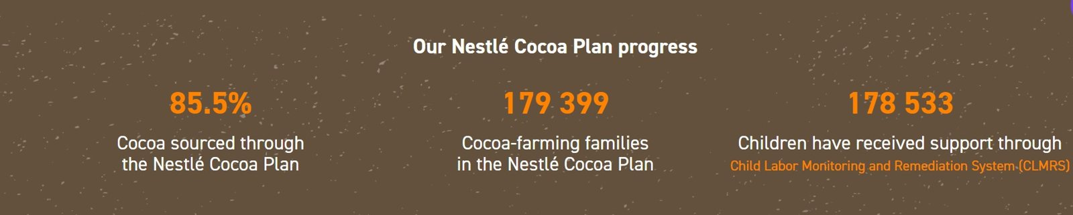
CASE STUDY: PACKAGING, LABEL AND COMPLIANCE WORKFLOW
Operational expertise beyond design: barcodes, label iterations and regulatory placement.
GS1 barcode process screenshot
Sindh Mela packaging design
Nestlé cocoa plan support chart
Field | Details
Service category | Packaging and regulatory/process support
Work completed | GS1 barcodes, label iterations, ingredients/facts verification, PSQCA/PFA placement process.
Proof available | Proof screenshots and slide evidence.
Portfolio positioning | Use as operational expertise; avoid showing sensitive product details.
Creative Linkage | Professional Portfolio
11

Slide 12
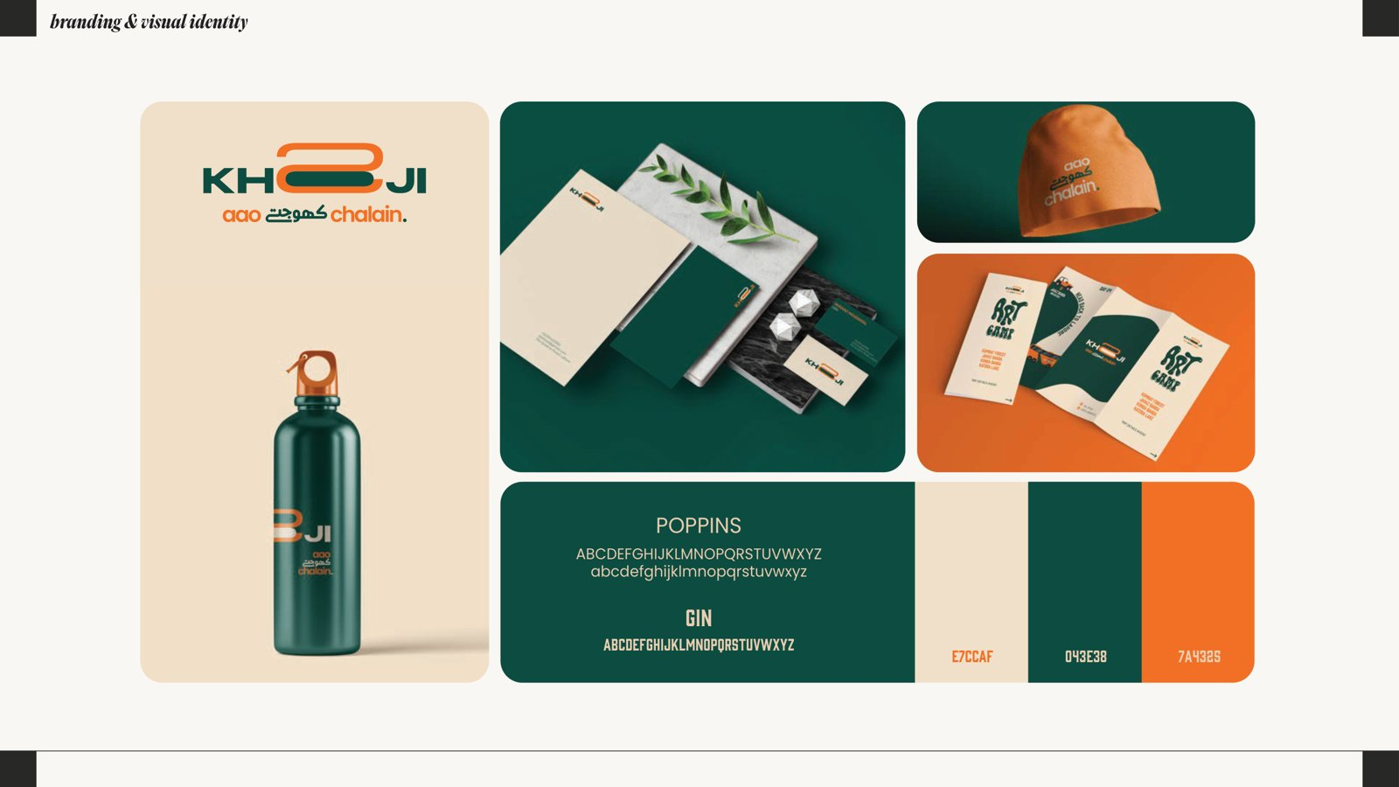
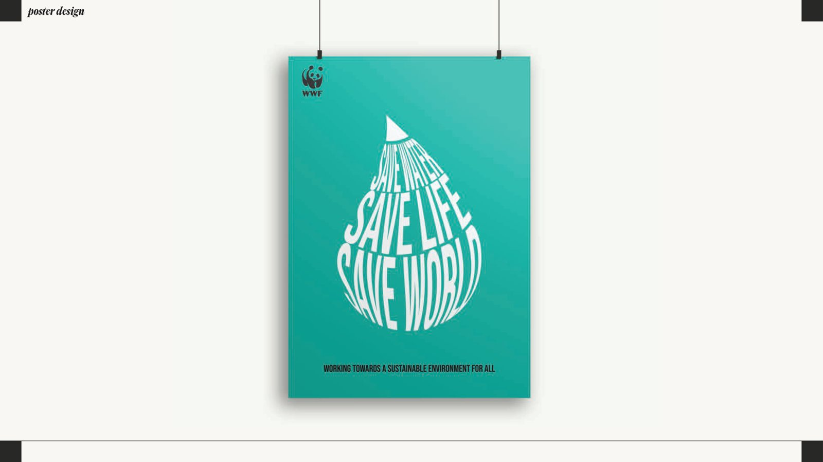
CASE STUDY: IDENTITY SYSTEMS
Brand identity work should be shown as a system, not only as a logo.
Pakeans identity
Khooji identity
Poster design sample
Field | Details
Service category | Graphic design and visual identity
Work completed | Logos, palettes, typography, mockups, stationery and packaging-style mockups.
Proof available | Design portfolio PDF pages.
Portfolio positioning | Strong design portfolio section; clarify designer attribution where needed.
Creative Linkage | Professional Portfolio
12

Slide 13
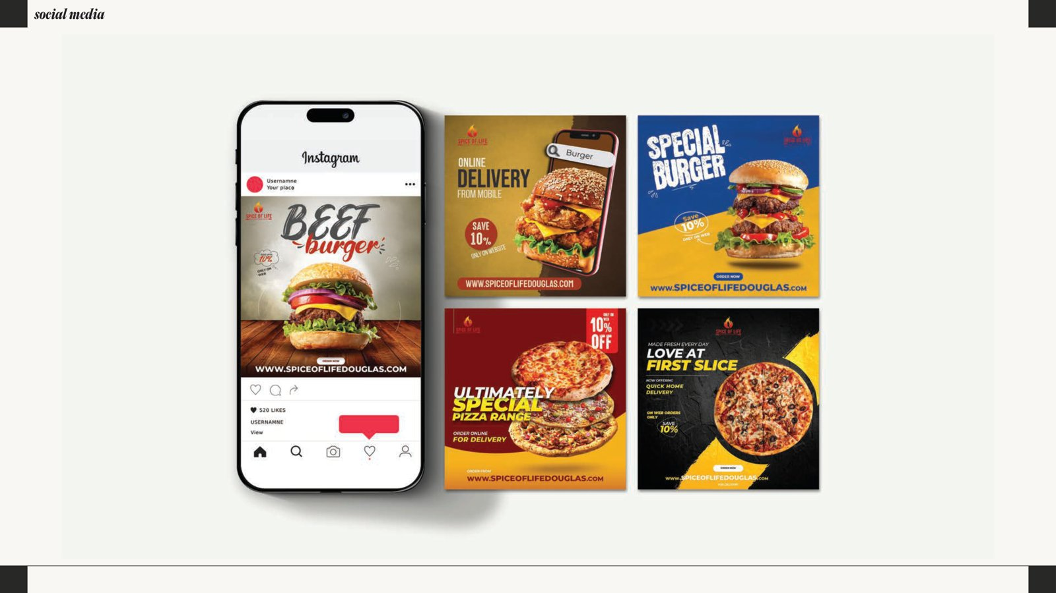
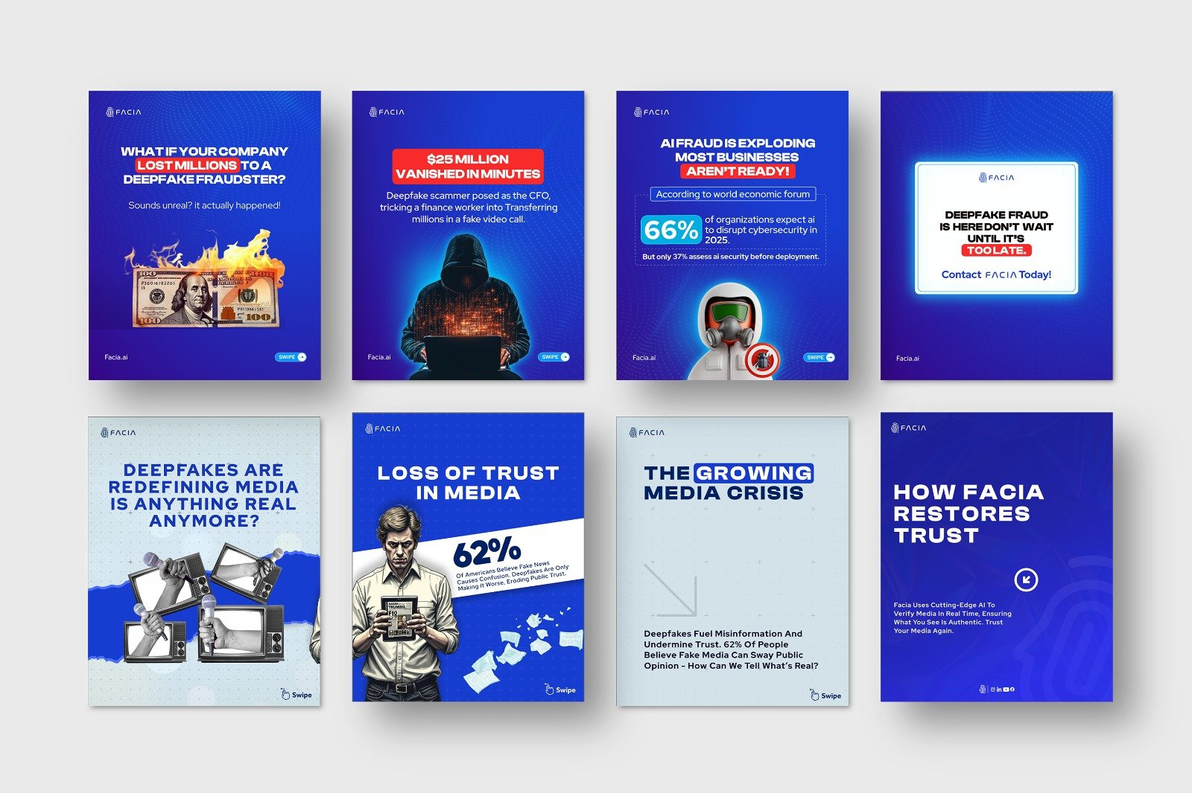
SOCIAL MEDIA AND DIGITAL DESIGN
Show campaign-ready visuals for service, restaurant and technology brands.
Pelican Tech social media
Spice of Life social media
Campaign creative set
Best use: present as design/content direction samples. Add analytics only if platform performance evidence is later provided.
Static post systems
Lead-generation creatives
Restaurant and food promotion
Customer support/service visuals
Campaign-ready visual direction
Creative Linkage | Professional Portfolio
13

Slide 14
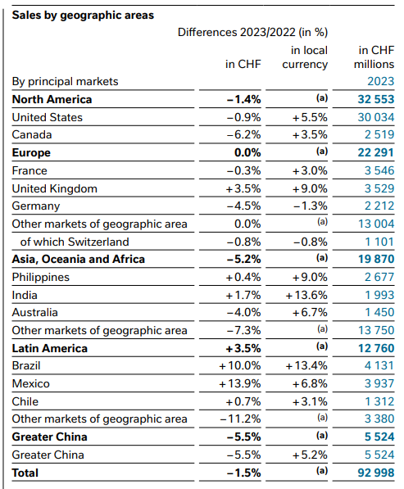
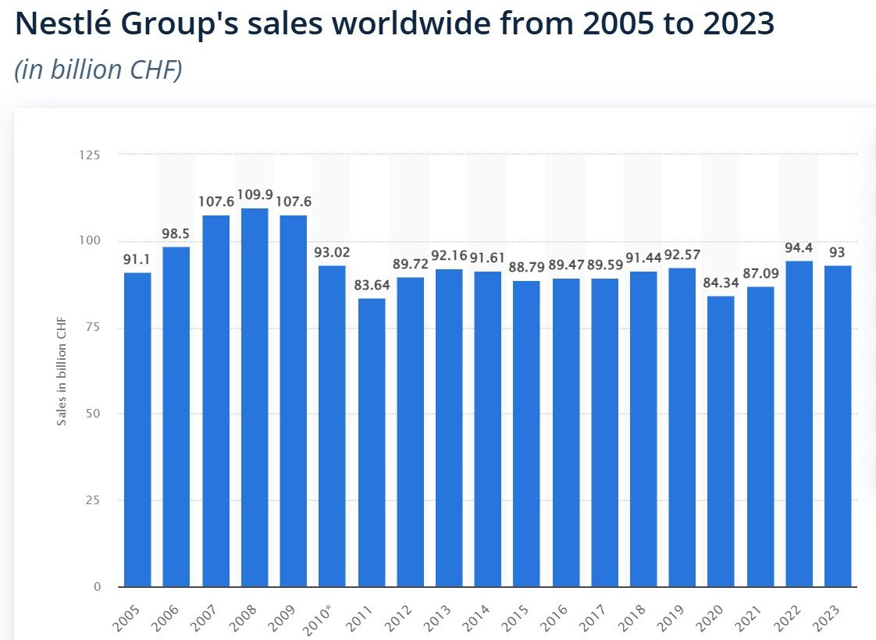
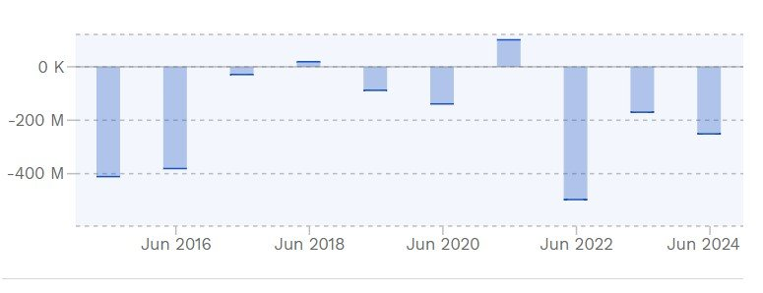
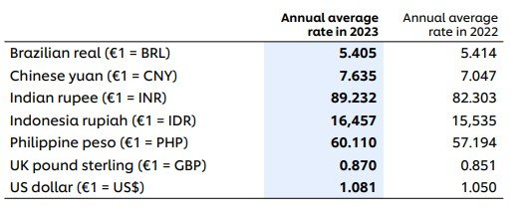
CASE STUDY: RESEARCH AND DATA ANALYSIS SUPPORT
A confidential research-support case with data preparation and analytical outputs.
Business / market table evidence
Exchange-rate chart evidence
Financial transaction table
Sales trend chart
Field | Details
Service category | Research / thesis support
Work completed | Questionnaire, coded CSV, SPSS SAV file, SmartPLS model and presentation.
Proof available | Files available in Australia work batch.
Portfolio positioning | Use as confidential research-support case after anonymization.
Creative Linkage | Professional Portfolio
14

Slide 15
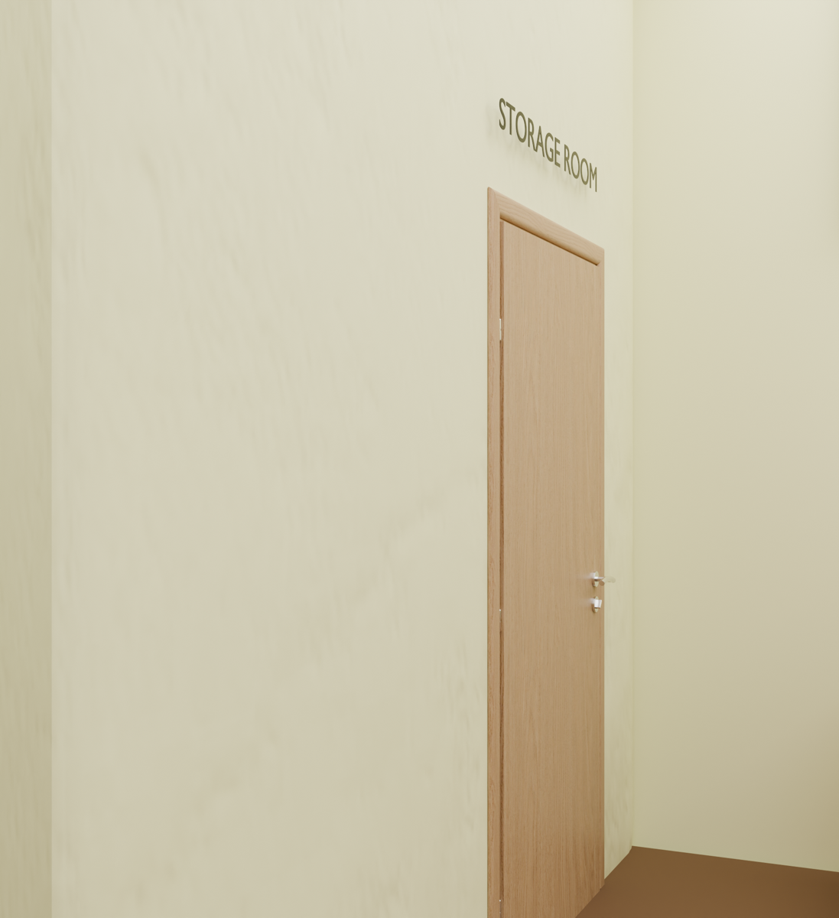
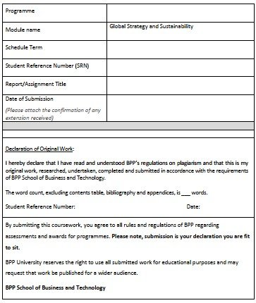
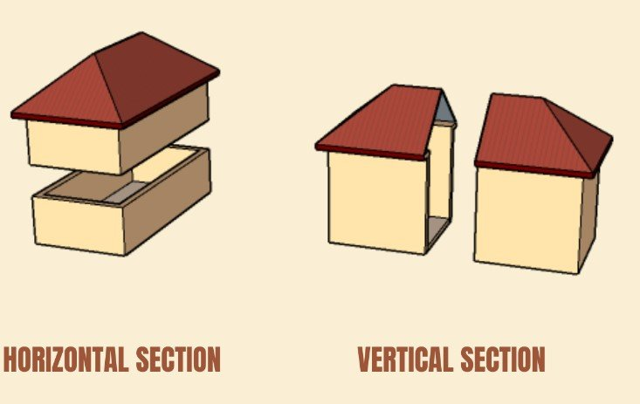
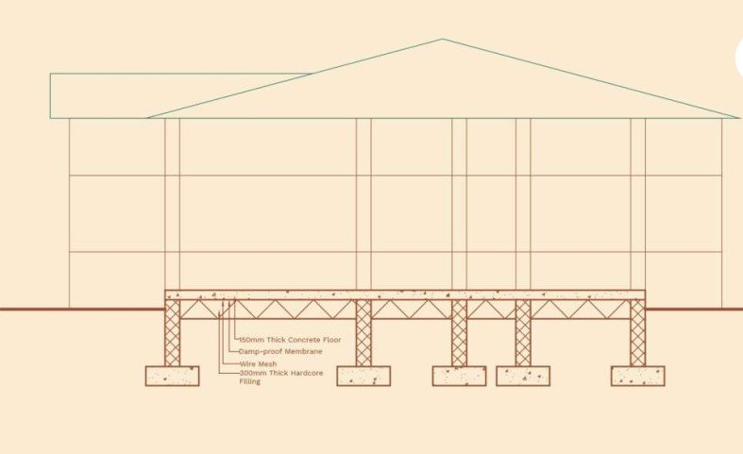
CASE STUDY: TECHNICAL REPORT AND DATA ARTEFACT SUPPORT
The technical portfolio should focus on summaries, outputs and documentation, not raw code dumps.
Cloud-management visual artefact
Report cover / template proof
Construction module visual
Section drawing
Field | Details
Service category | Technical report and data science artefact
Work completed | Python/IPYNB code, user guide, technical summary and output figures.
Proof available | Files available in final evidence batch.
Portfolio positioning | Strong technical writing/data artefact sample after anonymization.
Creative Linkage | Professional Portfolio
15

Slide 16
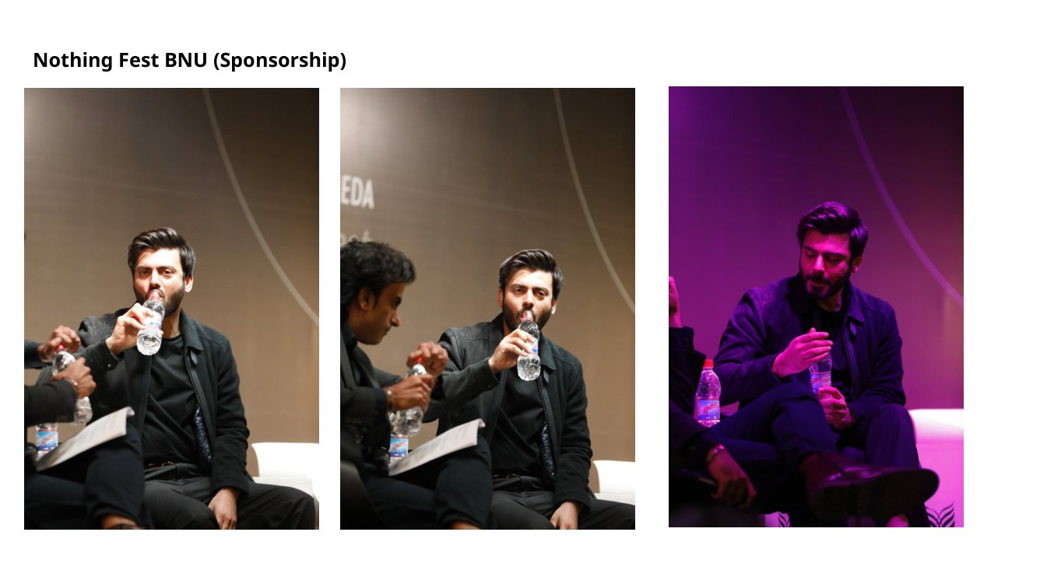
VISUAL PROOF GALLERY: ACTIVATION, EVENTS AND POSM
Selected proof-backed examples suitable as the main visual backbone, subject to approval.
Zeera buses
Pakistan Navy
Gift baskets
Sunwai sponsorship
BNU Nothing Fest
Gulf Expo key chains
Gulf catalogue
Sindh Mela design
Sindh Mela execution
Ramzan Bazar
Creative Linkage | Professional Portfolio
16

Slide 17
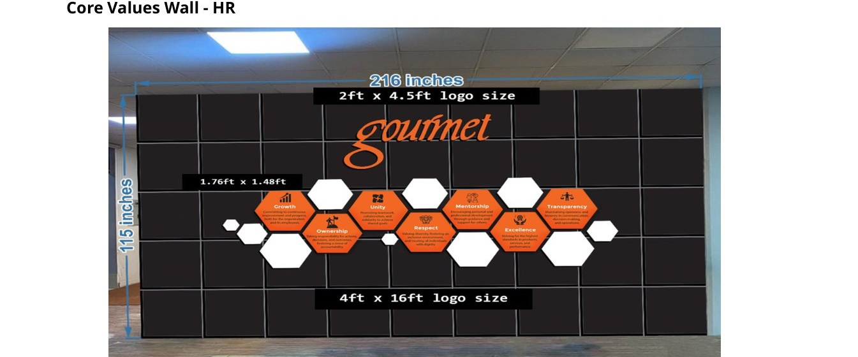
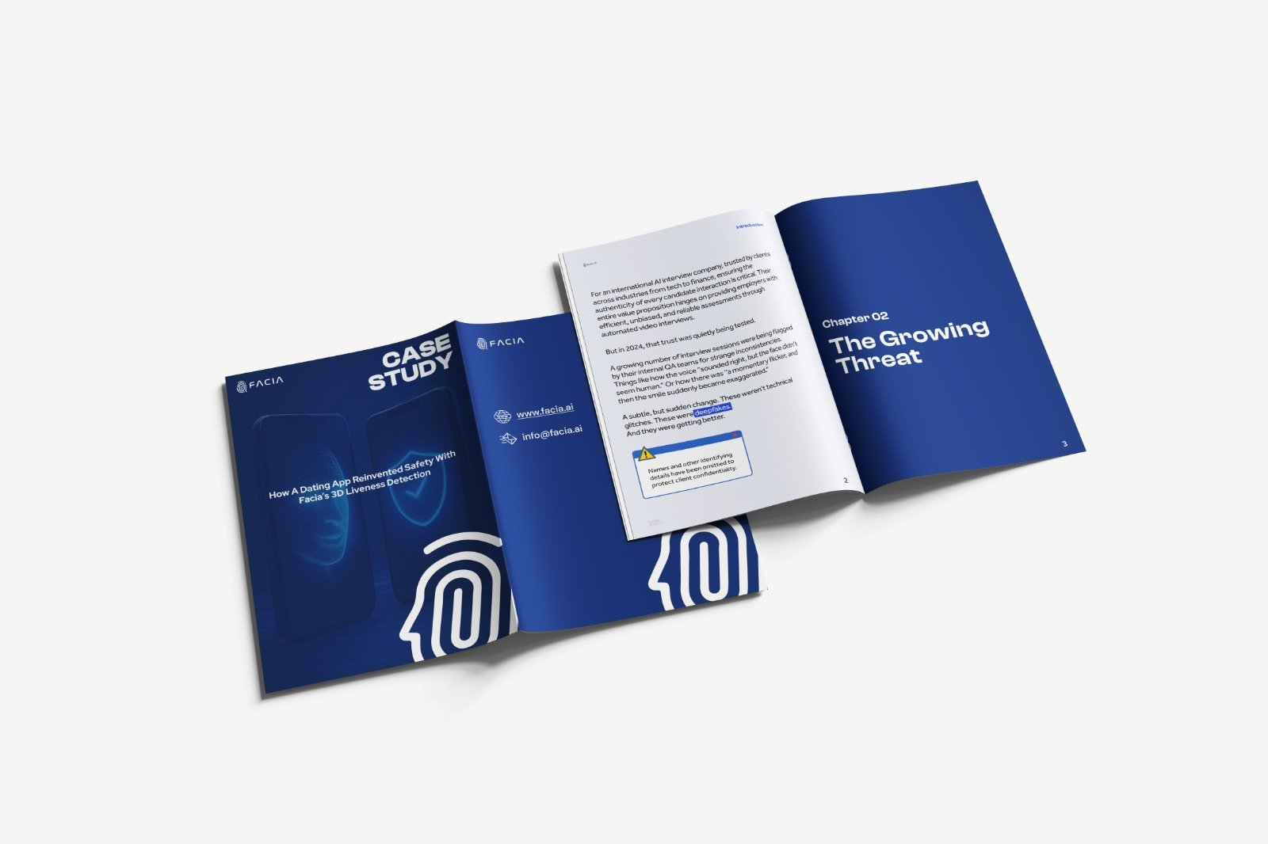

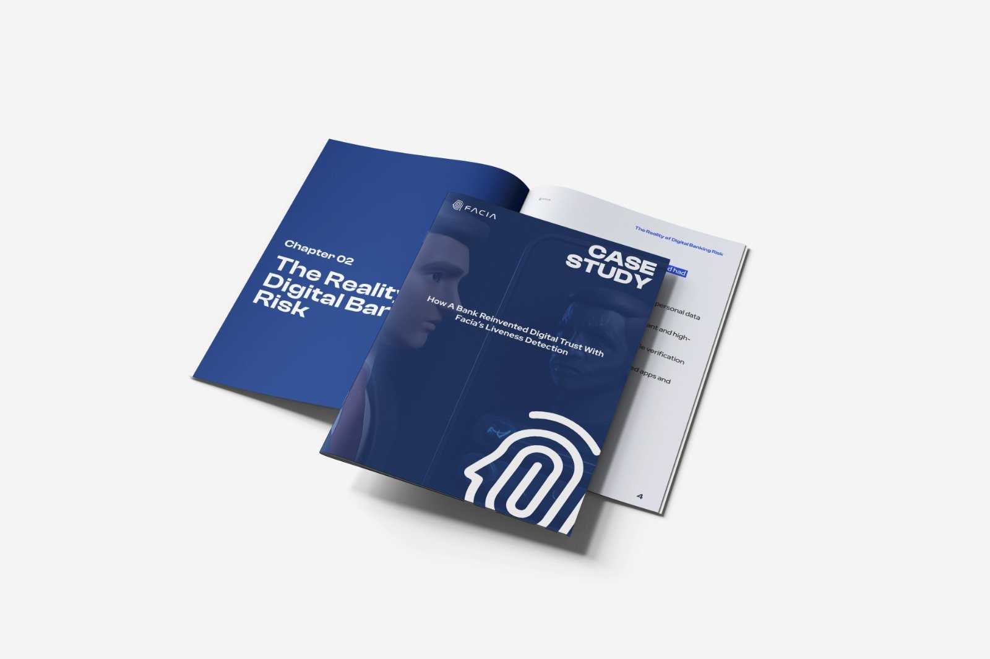
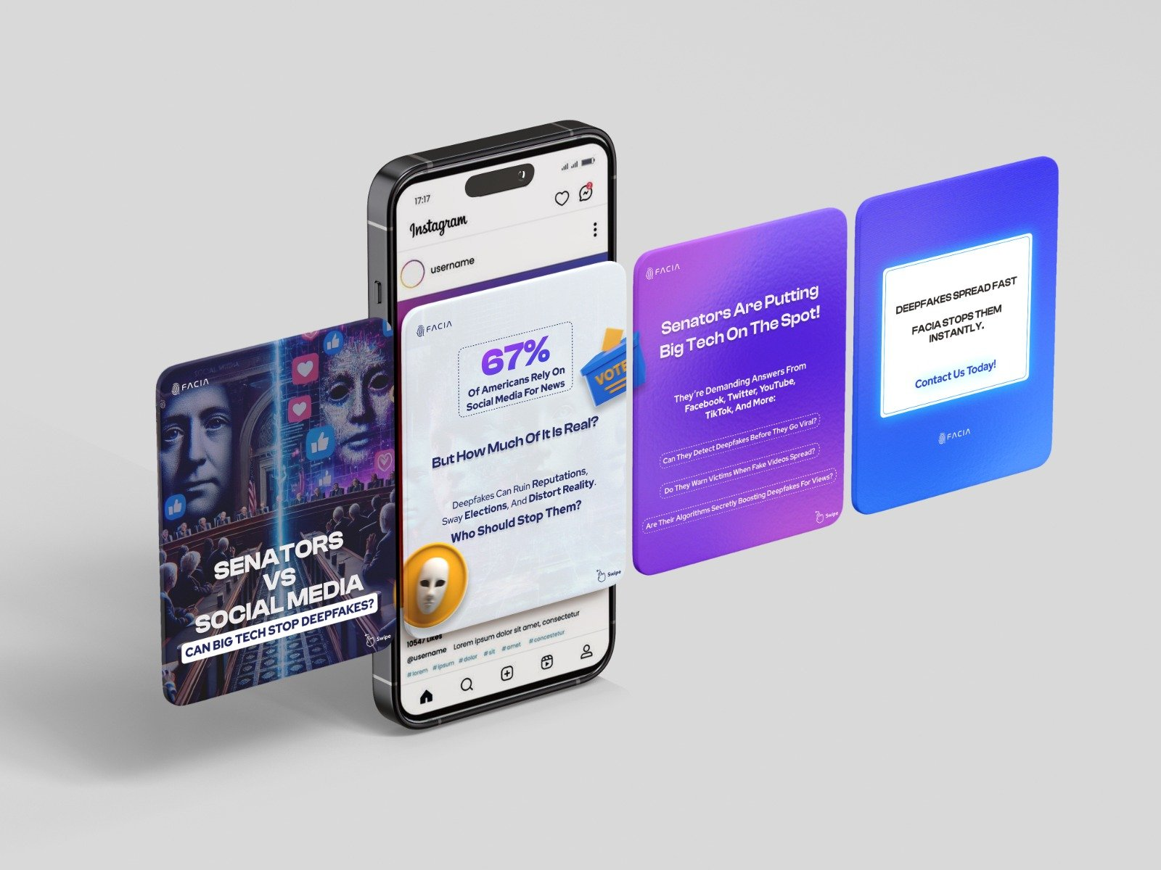
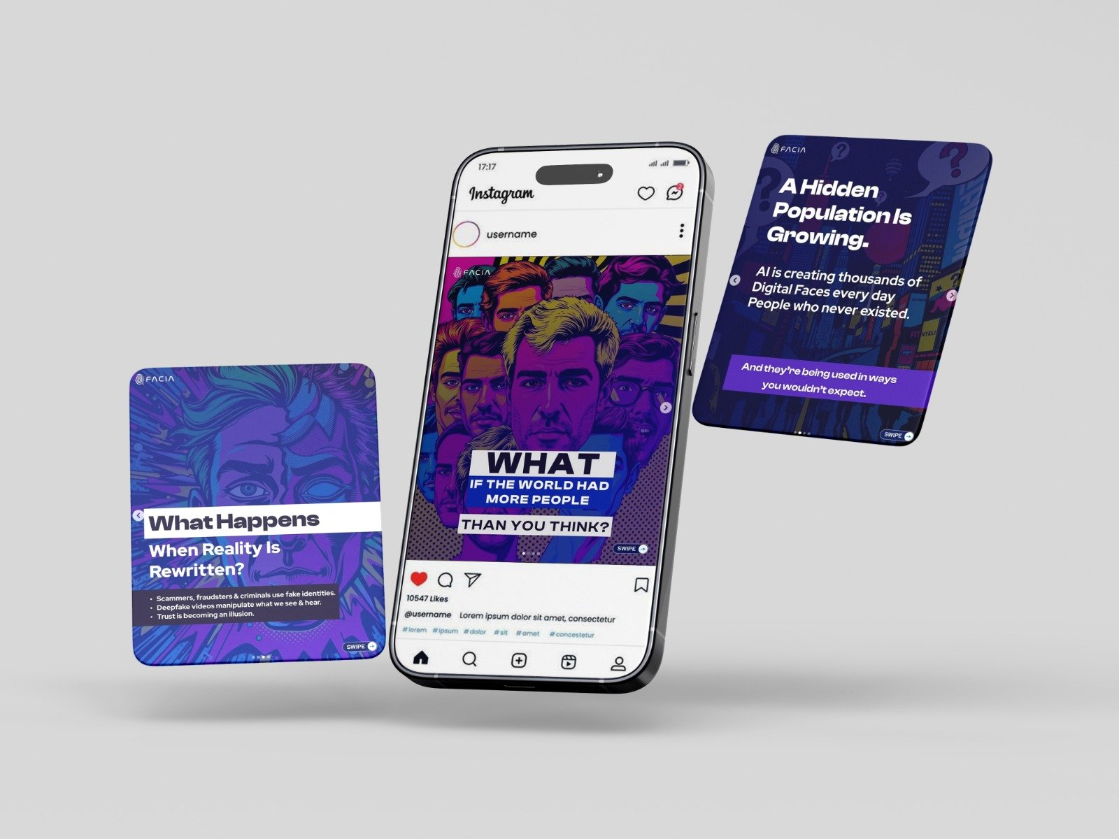
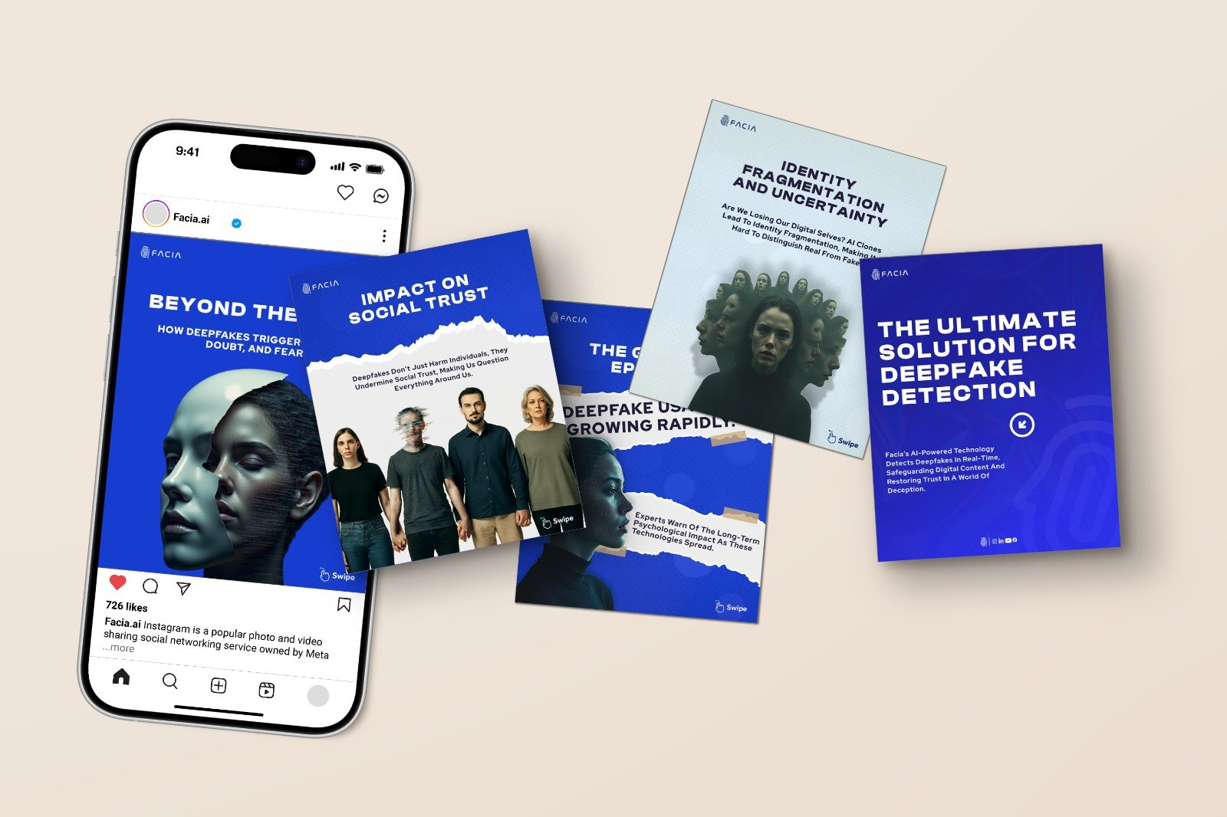
VISUAL PROOF GALLERY: IDENTITY AND DIGITAL CONTENT
Design proof is strongest when grouped by system, channel and use-case.
Pakeans
HR core values wall
Khooji
Pelican Tech
Spice of Life
Poster sample
Editorial design
Brochure spread
Publication mockup
Mobile content
Digital campaign
Cause campaign
Creative Linkage | Professional Portfolio
17

Slide 18
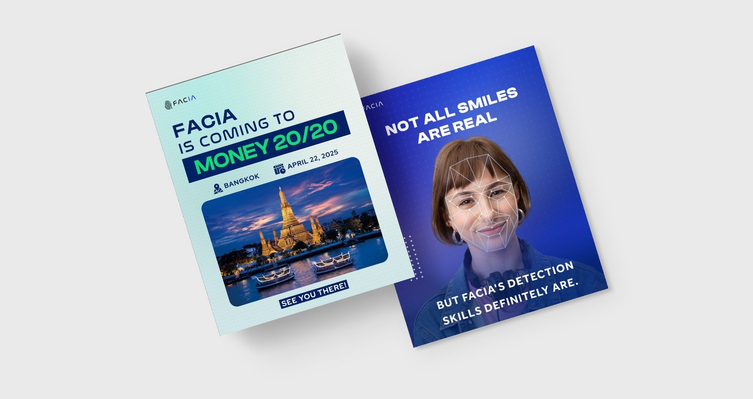
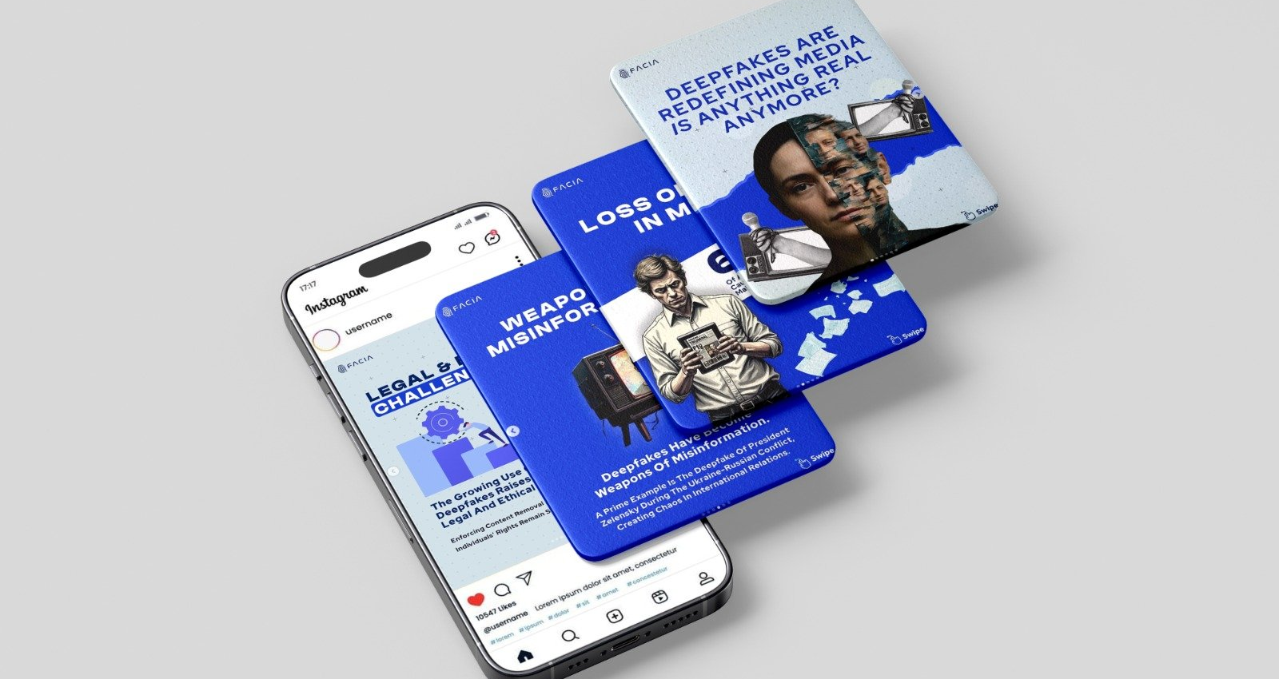
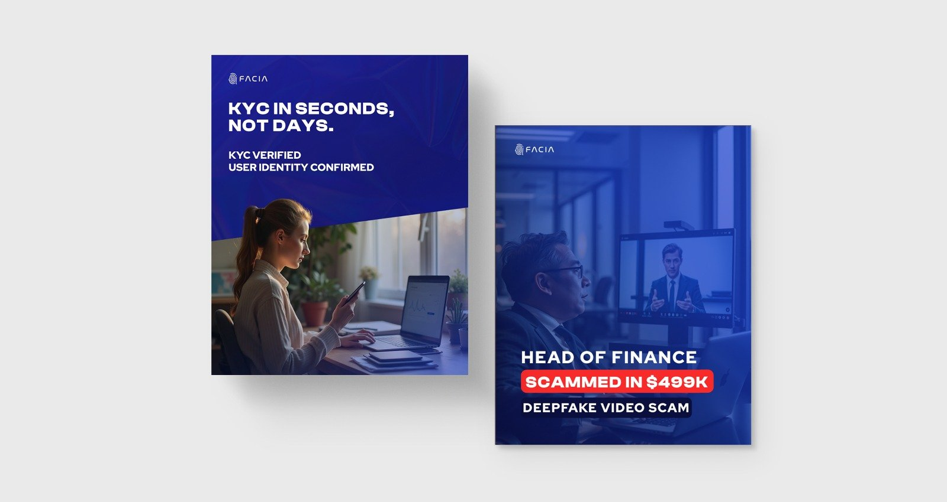
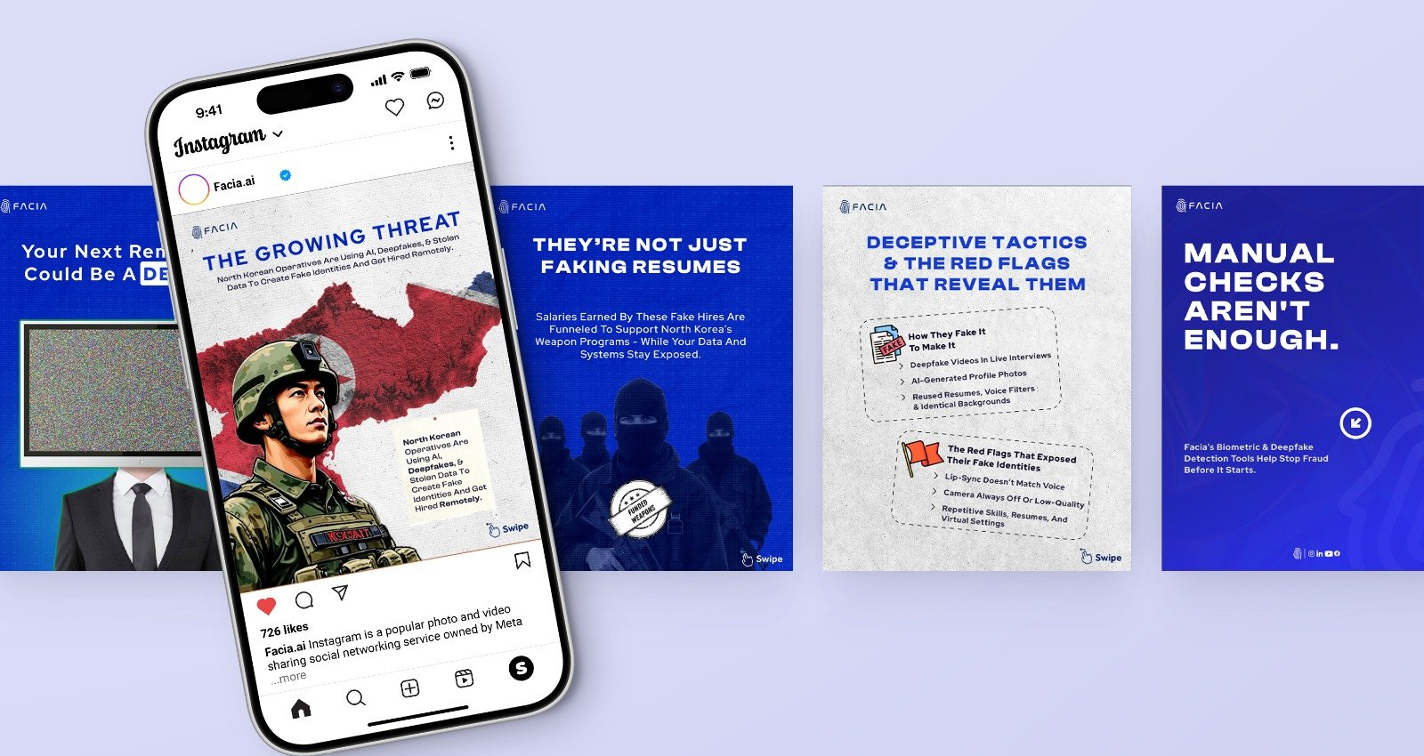
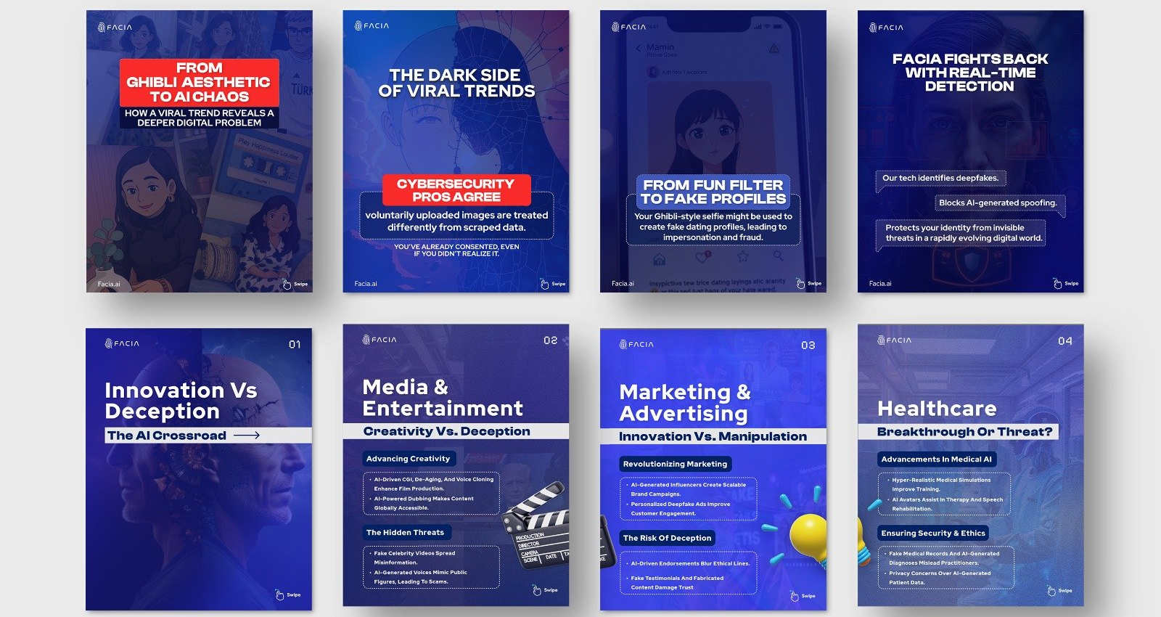
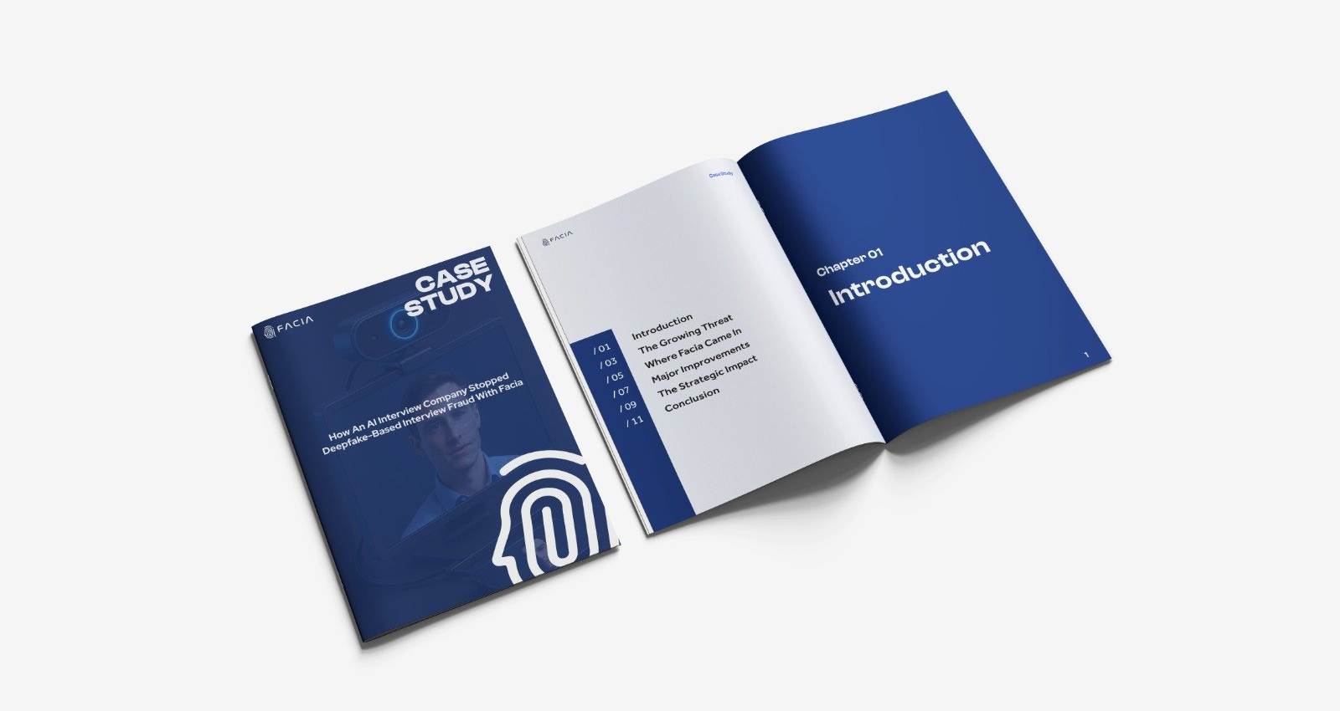
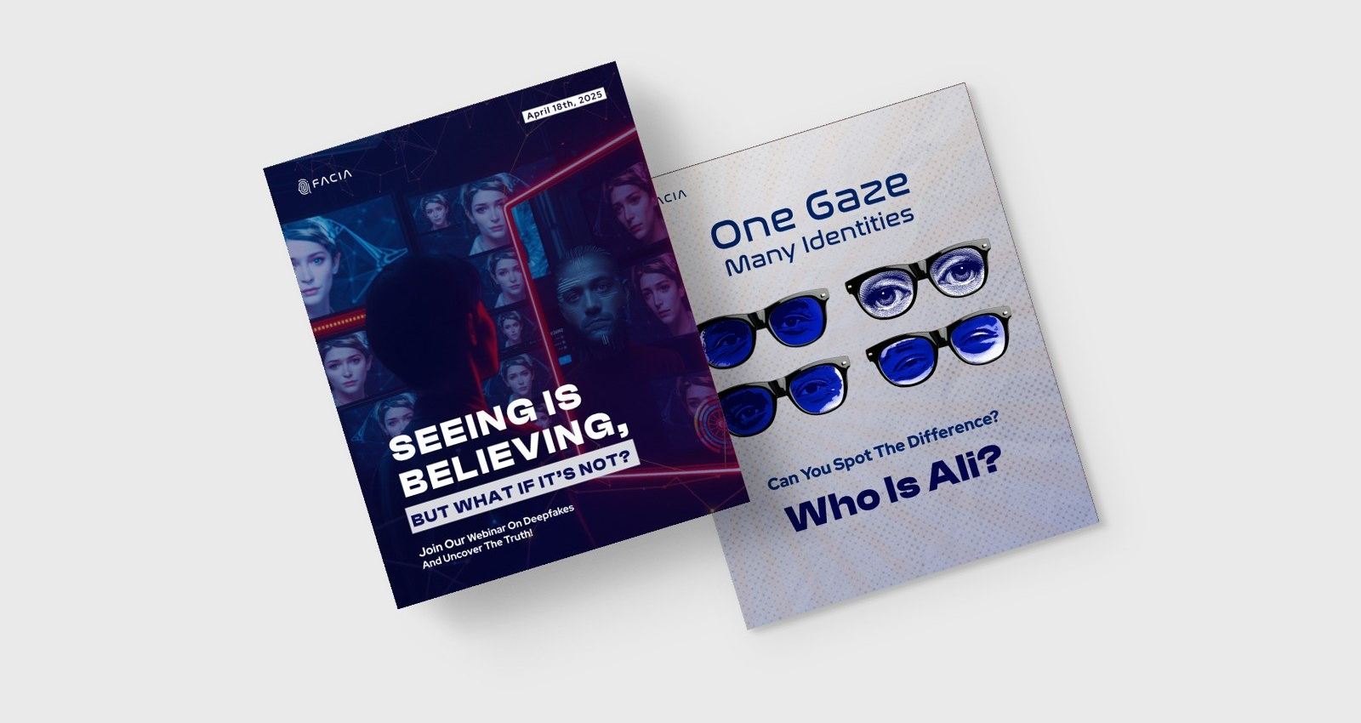
ADDITIONAL PROOF IMAGES: DIGITAL AND PUBLICATION MOCKUPS
These 14 images should be manually reviewed before external use because context and ownership are not specified in filenames.
Blue booklet A
Blue booklet B
Booklet set
Mobile mockup
Mobile campaign
Multi-card post
News/editorial
Phone + assets
Social campaign
Business booklet
Messaging assets
Content grid
Booklet spread
Flyer
Creative Linkage | Professional Portfolio
18

Slide 19

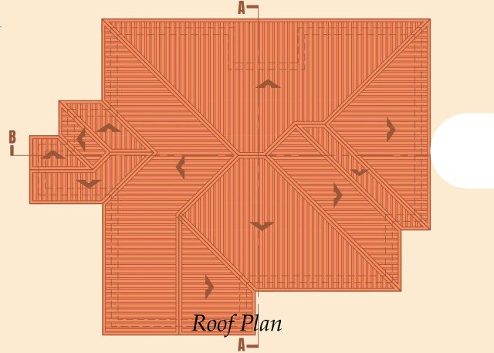
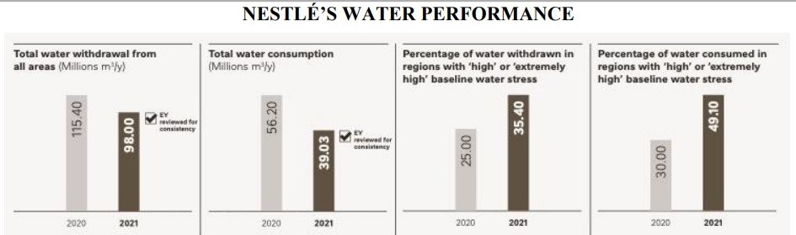
WRITING, RESEARCH AND TECHNICAL EVIDENCE GALLERY
Use these as proof of capability, not as raw public samples.
Sales by geography
Exchange-rate chart
Finance table
Cloud visual
Cover page
Yakult case mark
Cocoa plan
Sales chart
Water performance
Floor plan
Foundation section
Roof plan
Creative Linkage | Professional Portfolio
19

Slide 20
EVIDENCE REGISTRY: ACTIVATION, RETAIL AND POSM
The registry separates proof status, work type and public suitability.
Work / project | Service category | Work completed | Public suitability
GS1 Pakistan barcodes | Packaging compliance | Barcode portal screenshots showing 153 products and embedded bar codes | Acceptable if confidential product data is hidden
Pakistan Navy Hockey Tournament | Event sponsorship / activation | Sponsorship materials and venue branding | Use with permission
Zeera Cola branded buses | OOH / transit branding | Bus wrapping and branded vehicle visibility | Strong public sample
GICOH shirts | Merchandise / apparel branding | Shirt branding designs/execution | Public-ready if approved
Label revisions and comparatives | Packaging development | Multiple label workings and comparative reviews | Confidential process example
Gift baskets | Corporate gifting / promotional execution | Gift basket material handling and distributor strategy sessions | Strong visual sample
BIB box and machine branding | Retail branding | BIB box, machine branding and branded glasses | Strong operational sample
Gulf Expo collateral | POSM / merchandise | Key chains, cards, boxes, coasters, tote/catalogue/bag | Strong event sample
Creative Linkage | Professional Portfolio
20

Slide 21
EVIDENCE REGISTRY: EVENT EXECUTION AND SEASONAL ACTIVATION
Planning proof and execution proof are both included, but they should not be mixed with unsupported outcome claims.
Work / project | Service category | Work completed | Public suitability
Sindh Mela designs and execution | Event activation / retail display | Poster/banner design and on-ground execution | Strong case study sample
Trade Plan banners | Sales collateral | Banner designs made for trade plan | Public-ready
Apna Gourmet Cola POSM | POSM / retail activation | Stickers and banners execution | Public-ready
Horeca free tasting plan | Sampling / activation planning | Free tasting plan prepared but postponed | Planning sample only
Zeera Cola bakery activation | Retail sampling / bakery activation | Activation plan and bakery execution visuals | Strong sample
Gourmet shirts and caps | Merchandise / apparel branding | Branded shirts and caps | Public-ready with approval
Ingredients and facts verification | Regulatory label process | Ingredients and facts verification for label process | Confidential operations sample
Ramzan Bazar Activation 2025 | Seasonal activation / booth execution | Branded activation setup | Strong case study sample
HR Core Values Wall | Internal branding / culture wall | Core values wall design/execution | Strong internal branding sample
Creative Linkage | Professional Portfolio
21

Slide 22
EVIDENCE REGISTRY: BRANDING, SOCIAL AND POSTER DESIGN
Design examples are strong, but attribution and permissions must be clear.
Work / project | Service category | Work completed | Public suitability
Pakeans identity | Logo and visual identity | Logofolio, colours, typography, coffee/cup/stationery mockups | Strong design sample
Khooji identity | Logo and visual identity | Logo, colours, stationery, cap, bottle and brochure mockups | Strong sample
Koyal identity | Logo and visual identity | Logo versions, colour palette and typography | Strong sample
Wrappies identity | Logo and visual identity | Logo versions, colour palette and typography | Strong sample
Pelican Tech social media | Social media design | PV solar, customer support, lead-gen and appointment setting creatives | Strong sample
Spice of Life social media | Social media design | Burger, pizza, online delivery and first-slice creatives | Strong sample
WWF-style poster | Poster design | Save Life Save World sustainability poster | Use carefully if concept/student work
Alkhidmat Palestine poster | Poster / advocacy design | Peace over persecution poster | Use carefully; sensitive cause-related content
UCAD concert poster | Event poster design | Concert ticket poster design | Strong event poster sample
Creative Linkage | Professional Portfolio
22

Slide 23
EVIDENCE REGISTRY: COPYWRITING AND BUSINESS WRITING
Brand case files must be presented as writing subjects, not endorsements.
Work / project | Service category | Work completed | Public suitability
Creative Linkage profile | Company profile / positioning | About us, tagline, mission, vision, services, brand promise, counters | Public-ready after proof behind counters
L’Oréal business operations package | Business writing / operations | Word, PDF and PPT business operations materials | Confidential writing sample
Nestlé global operations package | Business writing / strategy | Documents, PPT and supporting charts on globalized operations | Anonymized case-study writing sample
P&G operations/strategy package | Business writing / operations | Word, PDF, PPT and exchange-rate evidence image | Academic/business writing sample
PepsiCo strategy package | Business writing / strategy | Word, PDF and PPT materials | Writing sample
Unilever operations package | Business writing / operations | Word, PDF, PPT and financial transaction image | Writing sample
Coca-Cola operations & information systems | Business writing / operations and IS | Recovered Word and PPT covering economy, technology, operations, IS and recommendations | Writing sample, not client work
DHL strategic management | Business strategy writing / PPT | International strategic management Word, PDF, PPT and data notes | Academic writing sample
Creative Linkage | Professional Portfolio
23

Slide 24
EVIDENCE REGISTRY: RESEARCH, ACADEMIC AND TECHNICAL REPORTS
These samples need heavier anonymization because the source archives include personal and academic material.
Work / project | Service category | Work completed | Public suitability
Foodpanda BRM research | Research writing / data analysis | Research file, questionnaire, coded CSV, SPSS SAV, SmartPLS model, PPT | Strong sample after anonymization
Cloud management assignment | Technical report writing | Cloud file, final assignment and supporting image | Technical writing sample
Cybersecurity business/compliance | Technical report writing | Cybersecurity for business and management compliance assignments | Strong technical writing sample
Cybersecurity research | Research writing | Final files and methods support PDF | Research-support sample
Healthcare leadership | Academic writing / leadership | Formative/summative assignments, policy/governance slides and frameworks | Anonymized sample
Finance for decision makers | Business/finance report writing | Final finance assignment and supporting PDFs | Writing sample
Global strategy and sustainability | Strategy & sustainability writing | Yakult/Nestlé strategy materials, PPTs, images and PDFs | Case-study writing sample
Business ethics and law | Academic writing | Strategy/business ethics, UK business law and leadership files | Anonymized sample
Creative Linkage | Professional Portfolio
24

Slide 25
EVIDENCE REGISTRY: TECHNICAL DOCUMENTATION AND PROJECT SUPPORT
This area supports report preparation and documentation more strongly than polished web-development case studies.
Work / project | Service category | Work completed | Public suitability
Architecture/construction module work | Technical / assignment documentation | Floor plan, roof plan, section drawings and module documents | Technical support sample
Bitcoin anomaly detection artefact | Technical report / data science | Python/IPYNB, user guide PDF, technical summary, confusion matrix, feature importance, anomaly outputs | Strong technical sample if anonymized
Phishing email detection artefact | Cyber/security artefact | Artefact submission files including code/data outputs | Strong technical sample after anonymization
Dissertation/research support | Thesis/research writing | Multiple dissertation, proposal, questionnaire, consent, SPSS/SPV and SmartPLS files | Do not publish raw; summarize capability
CV and career documents | CV / cover letter / career documentation | CVs, cover letters, experience letters and PDP documents | Private evidence only
Python project archive | Programming / development support | Large Python project archive with code, libraries and dependencies | Manual filtering needed
Packet tracer / networking assignments | Technical assignment / simulation | Packet tracer assignment files and reports | Use after review
Lab report archive | Science / technical reports | Lab reports and scientific source PDFs | Anonymized technical writing sample
Creative Linkage | Professional Portfolio
25

Slide 26
PUBLIC-USE GUIDANCE
A professional portfolio should show enough proof to build confidence, not enough raw material to create risk.
Action | Material | Reason
Use strongly | Zeera/Gourmet activation visuals, Gulf Expo collateral, Sindh Mela, Ramzan Bazar, visual identity work, social media samples. | Strong visual proof and explainable deliverables.
Use with permission | Pakistan Navy, Sunwai Foundation, BNU, GS1/PFA/PSQCA process screenshots, brand-owned visuals. | Public sharing should be approved or lightly redacted.
Use only as confidential samples | Academic assignments, CVs, dissertations, SPSS/SmartPLS data, consent forms, research datasets. | Raw use may expose personal data or academic details.
Do not overclaim | L’Oréal, Nestlé, P&G, PepsiCo, Unilever, Coca-Cola case files. | Treat as writing subjects unless direct engagement proof exists.
Needs verification | 500+ projects, 100+ clients, 50+ cities, 10+ industries. | Counters are present in source copy, but supporting evidence was not uploaded in full.
Needs attribution clarity | Abdullah Design Portfolio.pdf / Graphic Design by Umair Mughal. | Clarify team, collaborator or sample attribution before public use.
Creative Linkage | Professional Portfolio
26

Slide 27
PORTFOLIO VERSIONS TO BUILD FROM THIS MASTER FILE
Use the same evidence, then tailor the story for the audience.
Portfolio version | Core angle | Best audience
Universal portfolio | 360° brand activation, retail branding, POSM, digital and writing support company. | Broad agency prospects.
Marketing agency portfolio | Activations, sponsorships, bus branding, retail displays, expo POSM and merchandising. | BTL, FMCG, retail and beverage brands.
Branding & social media portfolio | Identity systems, social media creatives and poster samples. | Startups, restaurants, tech and design retainers.
Copywriting / business writing portfolio | Company profile, website-ready service copy and business case-writing examples. | SMEs, startups and business-report projects.
Thesis / research portfolio | Foodpanda BRM, SPSS/SmartPLS, questionnaire, dissertation and proposal samples. | Research-support projects only; anonymize heavily.
Technical report portfolio | Cloud, cyber, data artefact, packet tracer, lab and finance report evidence. | IT, cyber, data and report-writing projects.
Web / automation documentation portfolio | Technical summaries, code artefact guide and project documentation evidence. | Technical documentation and project-report work.
Creative Linkage | Professional Portfolio
27

Slide 28
ARCHIVE-LEVEL EVIDENCE SUMMARY
The master archive is large; only selected proof should appear in external pitch decks.
Archive | Files counted | Main file types | Major themes
loreal | 42 | .pdf, .docx, .pptx, .png, .jpg | Business/strategy/operations writing packages and supporting charts.
cloud_management | 84 | .docx, .pdf, .jpg, .pptx, .png | Global strategy, Yakult/Nestlé materials, cloud, cyber, finance and leadership.
australia_work | 128 | .docx, .pdf, .jpg, .pptx, .settings, .png | BRM research, Foodpanda, data, SPSS/SmartPLS, technical plans.
old | 7,638 | .py, .pyc, .pyi, .png, no extension, .pdf | CVs, MSc management, business development, Python projects, packet tracer, lab reports.
final_batch | 390 | .docx, .pdf, .jpg, .txt, .jpeg, .csv | APHW, CIS017 artefacts, dissertations, research, data science and SmartPLS materials.
Important: archive breadth is a credibility asset internally, but raw archives should never be sent as a portfolio. Select, sanitize and narrate the evidence.
Creative Linkage | Professional Portfolio
28

Slide 29
SERVICE-SPECIFIC MINI-PORTFOLIOS
Each mini-portfolio should lead with the strongest proof and carry clear usage notes.
Mini-portfolio | Best positioning | Best proof-backed examples / use notes
Marketing agency / activation | Execution-led brand activation and market visibility. | Lead with Zeera buses, Ramzan Bazar, Sindh Mela, Pakistan Navy, Sunwai and Gulf Expo. No sales/footfall claims unless supplied.
Branding & graphic design | Identity systems with logo, palette, typography and applications. | Lead with Pakeans, Khooji, Koyal, Wrappies and posters. Clarify Umair Mughal attribution.
Social media & digital content | Campaign-ready content for service, food, restaurant and technology brands. | Lead with Pelican Tech and Spice of Life. Add performance metrics only with analytics.
Copywriting & business writing | Professional reports, profiles, service copy and strategy documentation. | Use Creative Linkage profile and business case packages as writing subjects, not brand endorsements.
Thesis / research writing | Structured academic research support, data preparation and analysis documentation. | Lead with Foodpanda BRM, SPSS SAV, coded CSV, SmartPLS and questionnaires. Anonymize fully.
Technical report writing | Cloud, cybersecurity, data artefact, finance and lab report preparation. | Lead with cloud management, cyber compliance, Bitcoin anomaly and phishing email artefacts.
Web / automation documentation | Project documentation, summaries, user guides and evidence packaging. | Use CIS017-3 guide, technical summary and code/IPYNB outputs after filtering.
Creative Linkage | Professional Portfolio
29

Slide 30
NEXT STEP
Turn evidence into a focused presentation for the exact opportunity.
The full portfolio is broad. A strong pitch should be narrower: choose the service line, pick the best proof, remove risk, and present a clear next action.
1
Choose the pitch angle
2
Select proof-backed examples
3
Redact sensitive details
4
Attach a clear proposal or scope
Creative Linkage | Building the brands together
Creative Linkage | Professional Portfolio
30

